Slide 1
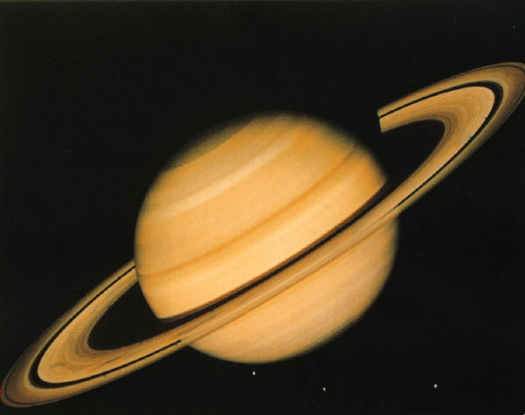

RL 11
By Lindsay and
Rachel

Slide 2


Scientific Method
Hypothesis-We think the egg will not break because of how many cotton balls we put in.
Experiment-Launch the rocket
Data and Conclusion-The egg broke, the rocket flew up high!

Slide 3
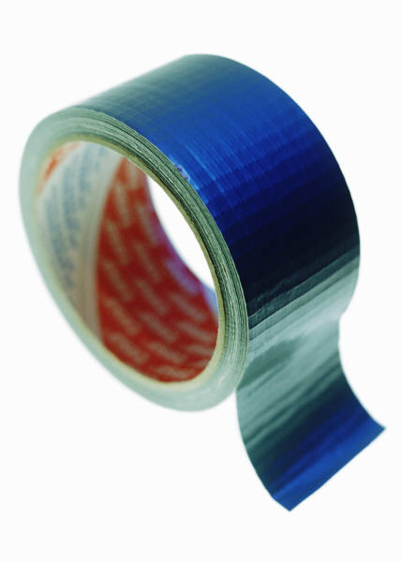

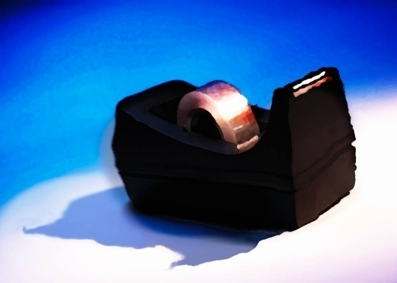
Materials Used
Bottle-bottle rocket
Cardboard-egg capsule
Paper-decoration
Really cool duct tape-decoration
Regular tape-sticking stuff together
Cotton balls-protection

Slide 4
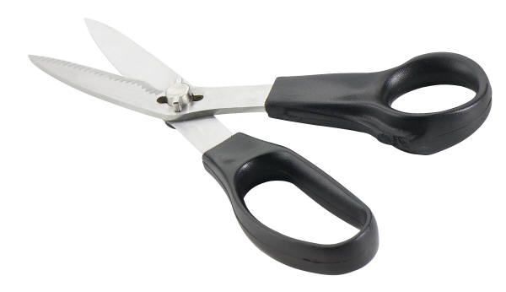

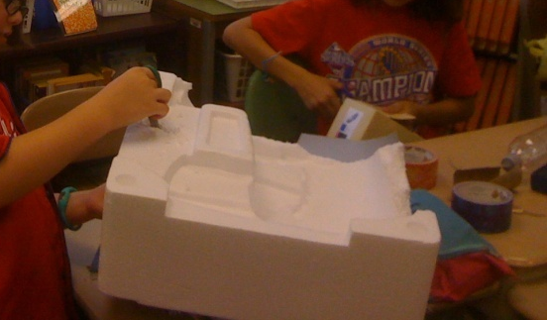
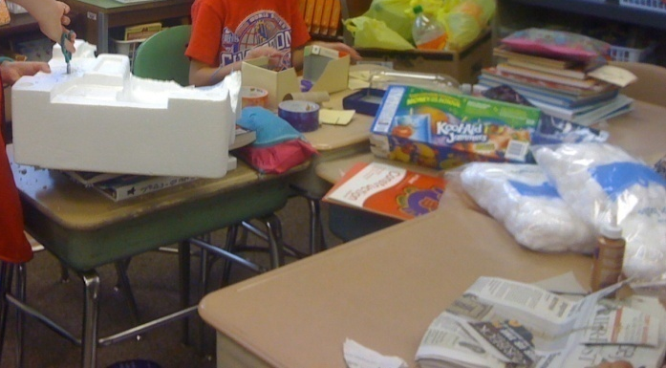

Building Procedure

Slide 5

Survival Rate
Survival
1%
Non survival
9%

Slide 6
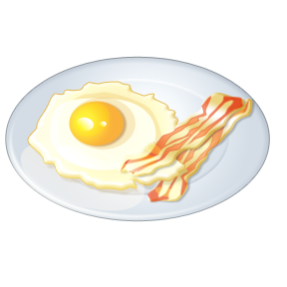
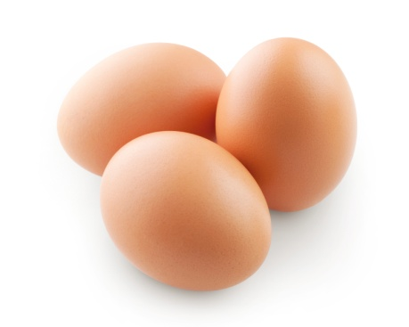
Comparison
Surviving Rocket
Our Rocket
Bubble Wrap | Cotton Balls
Duct Tape | Duct Tape
Plastic Cup | Cardboard
Dark Blue : Protection
Light Blue : Decoration
Lightest Blue :: Capsule
Their egg:
Our egg:

Slide 7

Our rocket flew up in the air but the egg , Bob, did not survive. ☹. We think it was because we did not put enough protection in the capsule. As for the rocket, it was a success! ☺! We made it very light so it would go higher. The rocket was perfect, the egg, not so much.

