Slide 1


The Shooting Star!
Created by:
Laurel
And
Justin

Slide 2

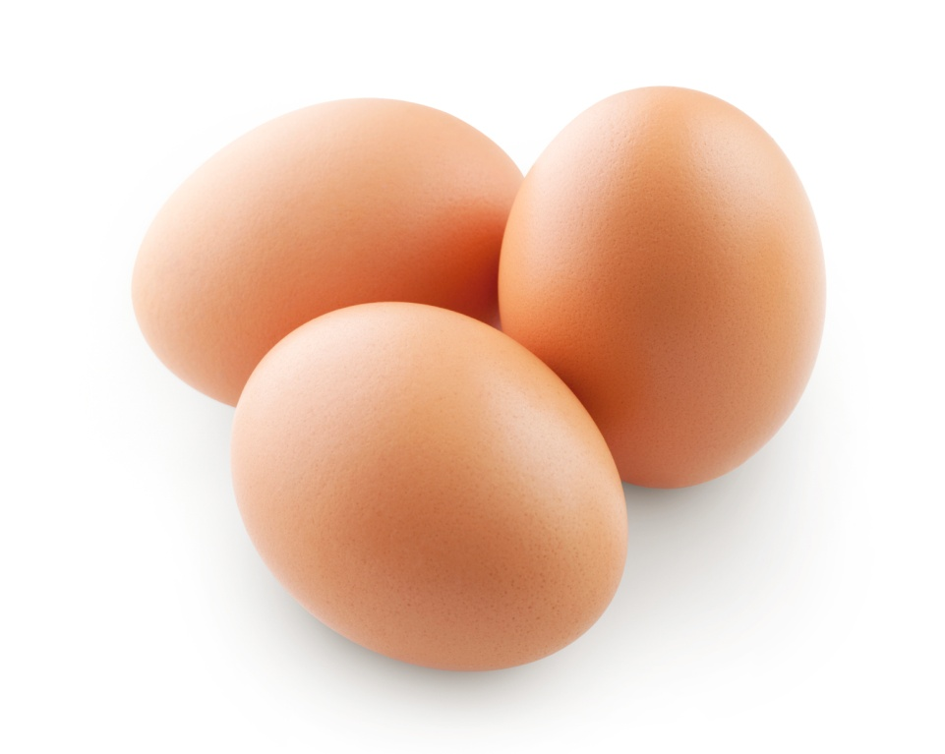
Scientific Method
The purpose of making our bottle rocket was to try protecting our egg at launch so it would survive.

Slide 3
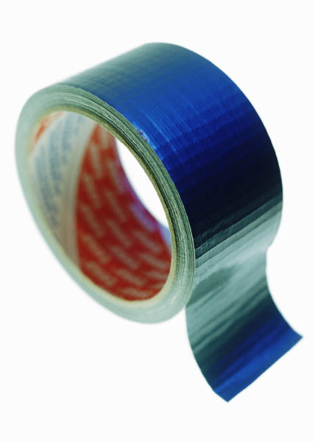
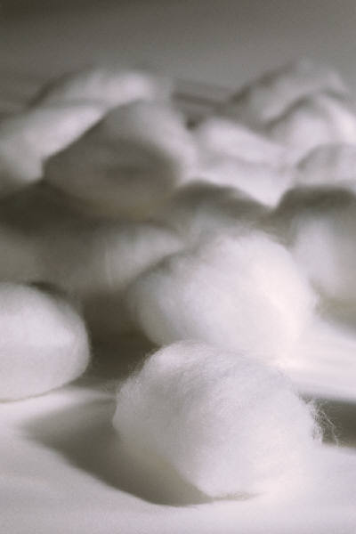


Materials
The materials we used to create the rocket were bubble wrap, cardboard, duct tape, cotton balls, and construction paper. We used those things to make our rocket fly up into the air.

Slide 4
Building Procedure
We first cut out fins into triangles. Then we made a cone.
We used duct tape to attach the cone and fins to the bottle and taped bubble wrap on the cone.
To complete the rocket, we put some stickers to decorate it and stuffed the cone with cotton balls.

Slide 5
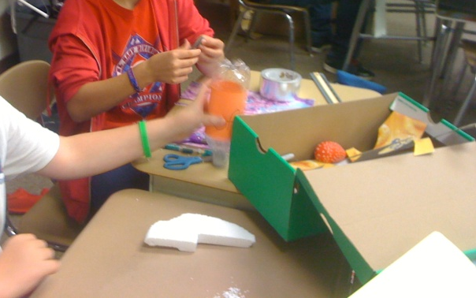
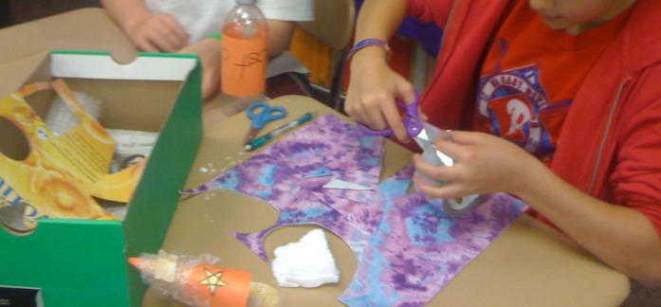
Building Procedure Pictures
This is us making our awesome
rocket in Mrs. Hull’s classroom!

Slide 6
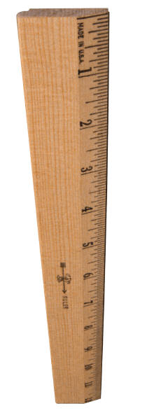

Our Hypothesis
We predicted that our rocket would go at least 15 feet in the air. Also, we didn’t think our egg would brake.

Slide 7
Data and Graph Chart
Unfortunately, our egg did not survive. It flew up into the air, then slammed back to Earth with a crack. It broke into pieces.

Slide 8
Comparison
I think if we put bigger fins on the bottom of our rocket, it would have gone up higher. Also, if we used cardboard to protect our egg, I think it would have survived.
We thought that our rocket went higher than some others and lower than some others.
Comparing!

Slide 9

Our Conclusion
In the end, our awesome rocket was destroyed at landing. The egg did not survive and it turned out to be a failure. My partner and I had a great time making and flying our rocket.

Slide 10
YAY!
Thank you for watching our
slide show about The Shooting Star!

