Slide 1
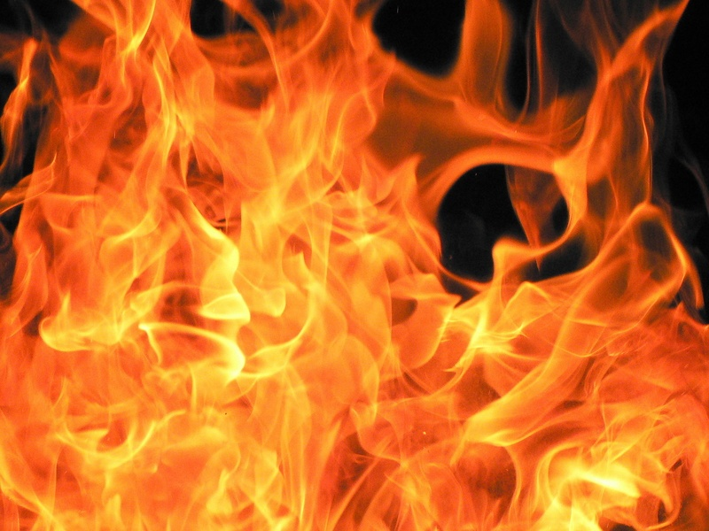
FIRESTORM 27-X
By:
Dante
And
Aidan

Slide 2
Will it survive?
Can our egg survive for tomorrow’s breakfast?
Will our design work correctly and go the way we want?
Will our specially designed parachute work?

Slide 3
Materials Used
Capsule-Cotton balls and foam inside plastic cup covered with bubble wrap
Fins-Cardboard and masking tape at the bottom of the rocket
Rocket-Soda bottle
Parachute-Foam, String, and masking tape

Slide 4
Building Process
● First, we designed our capsule.
We put cotton balls and foam in the plastic cup capsule to protect the egg.
●Next, we made a foam, string, and masking tape parachute to make the rockets landing safer for the egg astronaut.
●Later, we designed our rocket, we wanted to make it simple and light-weight.
● So for not much weight, we decided to make the fins out of cardboard, hung on by masking tape.
●We added the fairing, also made of cardboard and attached it to the capsule.

Slide 5

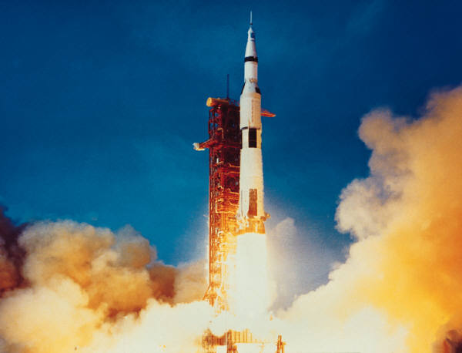
Hypothesis
Going into this rocket project we thought our design was going to work
But during the building the fins started to fall off so we had our doubts about the egg’s survival

Slide 6
Our comparison
Our rocket was very light weight so it had a higher travel than most of the other rockets
But, because our rocket was not as sturdy as the others, the egg did not survive
It might have gone higher than most, but it did not survive because it was not sturdy enough like some other rockets.

Slide 7
Chance of an egg’s survival

Slide 8
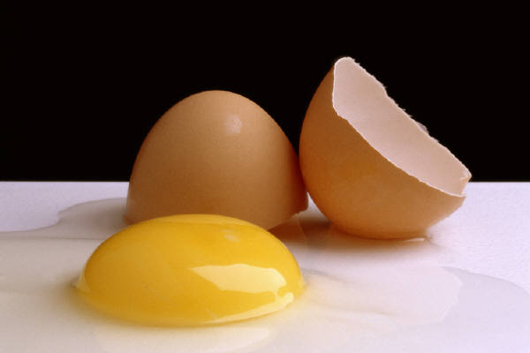
Conclusion:
The End of Neil Eggstrong
Our rocket went high with the stars, but Neil did not survive the landing unlike someone who resembled him, Neil Armstrong
So, in our conclusion Neil Eggstrong became breakfast. ☹

Slide 9
What We Would Change:
We would use softer material in our capsule to help protect the egg
We would have used more strong and stable materials to make the rocket go higher and have better stability
We would have used better material in the fins on the rocket to make the rocket have better durability

Slide 10
Credits
A power point made by:
Dante : Co-Producer
Aidan : Co-Producer

