Slide 1

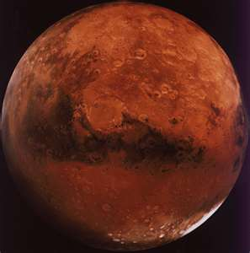
Expedition
Talia
Matthew
MARS
MARS

Slide 2
Building Procedure
We used all our materials to put a perfect rocket together.
We worked together to make:
Fins
Fairing
Egg capsule
And the whole design of the rocket!

Slide 3
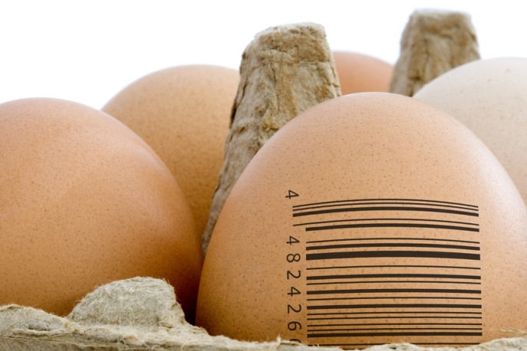
EGGstronaut protection
Our goal was to secure the egg in the capsule so it wouldn’t crack.
We used soft materials and wrapped the egg tightly so it hard to crack.
We hot glued it to the cone which was hot glued to the rocket.

Slide 4
Materials Used:
Cardboard
Two small plastic cups
Hot Glue
Construction Paper
Foam
Bubble Wrap
Markers
Peel-Off letters
Duct Tape

Slide 5
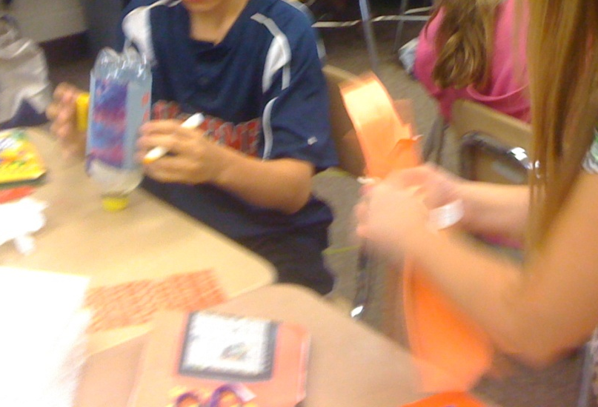
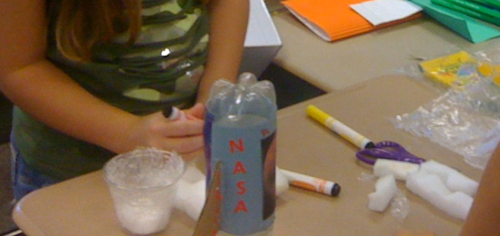
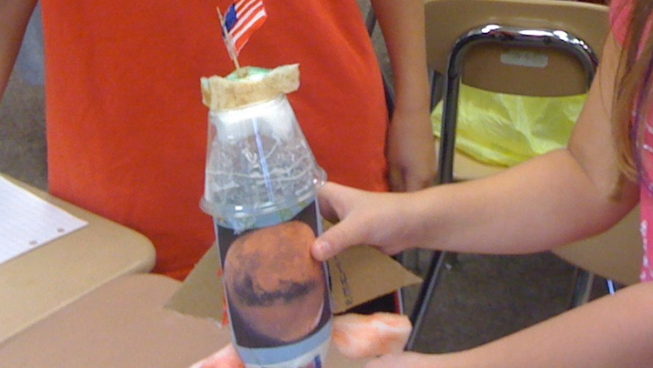
Finished project! ☺
Building…

Slide 6

Our Hypothesis
We predicted that our rocket would go high in the air.
.We also thought that it would go straight in the air , and land safely.

Slide 7
CHART OF EGG DATA

Slide 8
COMPARISON
Our Rocket flew high in the air, approximately 15 feet. It was almost the highest rocket in the class.
Our rocket was almost as light as a regular soda bottle, just about 1 ounce heavier. It was almost the lightest in the class.
It was highly decorated, and designed.

Slide 9
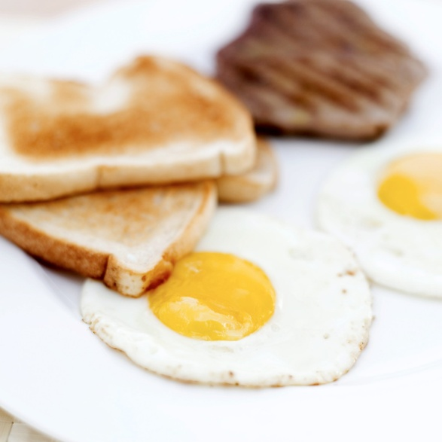
Conclusion
Our rocket and egg capsule did not break. It stayed as a whole.
Unfortunately, our EGGstronaut cracked at the top because the foam and bubble wrap was not wrapped at the top nor bottom.

Slide 10
THE END!
Thank you for watching
We hope you enjoyed! ☺
By: Talia and Matthew

